Slide 1
The Cortex-M3 Embedded Systems

Slide 2
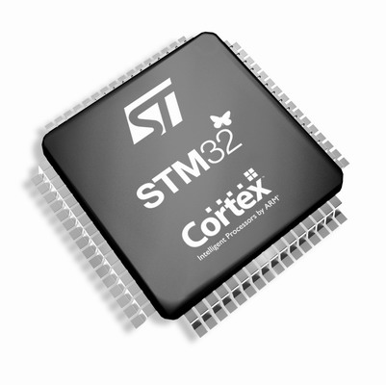
Chapter 1, 2, and 3 in the reference book

Slide 3
8.1 Embedded System
8.1.1 Definition
An embedded system is a computer system designed to perform one or a few dedicated functions often with real-time computing constraints.
Compare:
A general-purpose computer, such as a personal computer (PC), is designed to be flexible and to meet a wide range of end-user needs.

Slide 4
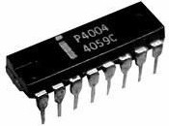
8.1.2 History
In the 1930–40s, computers were sometimes dedicated to a single task, but were far too large and expensive.
One of the first recognizably modern embedded systems was the Apollo Guidance Computer, developed by Charles Stark Draper at the MIT.
The first microprocessor, the Intel 4004, was designed for calculators and other small systems.
By the mid-1980s, most of the common previously external system components had been integrated into the same chip.
The integration of microcontrollers has increased the applications for which traditionally a computer would not.

Slide 5
8.1.3 Characteristics
1. Embedded systems are designed to do some specific task.
Some also have real-time performance constraints that must be met; others may have low or no performance requirements.
2. Many embedded systems consist of small, computerized parts within a larger device that serves a more general purpose.
3. The program instructions written for embedded systems are referred to as firmware, and are stored in read-only memory or Flash memory chips.

Slide 6
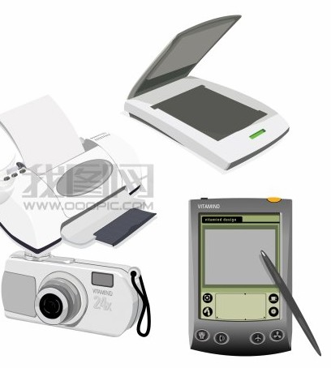
8.1.4 Application
Embedded systems span all aspects of modern life and there are many examples of their use.
Telecommunications systems employ numerous embedded systems from telephone switches for the network to mobile phones at the end-user.
Consumer electronics include
personal digital assistants (PDAs),
mp3 players, mobile phones
and videogame consoles.

Slide 7
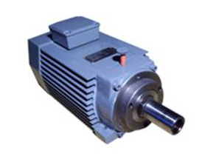
Transportation systems from flight to automobiles increasingly use embedded systems.
New airplanes contain advanced avionics such as inertial guidance systems and GPS receivers that also have considerable safety requirements.
Various electric motors — brushless DC motors, induction motors and DC motors — are using electric/electronic motor controllers.

Slide 8
8.1.5 Processors in Embedded Systems
Embedded processors can be broken into two broad categories: ordinary microprocessors (μP) and microcontrollers (μC).
1. A fairly large number of basic CPU architectures are used.
Von Neumann as well as Harvard architectures.
RISC as well as non-RISC and VLIW.
2. Word lengths vary from 4-bit to 64-bits and beyond (mainly in DSP processors).
3. Most architectures come in a large number of different variants and shapes.

Slide 9
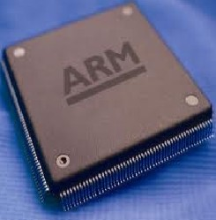
ARM
ARM, a company was known as the Advanced RISC
Machine, and before that as the Acorn RISC Machine.
As of 2007, about 98 percent of the more than one billion mobile phones sold each year use at least one ARM processor.
As of 2009, ARM processors account for approximately 90% of all embedded 32-bit RISC processors.
ARM processors are used extensively in consumer electronics, including PDAs, mobile phones, digital media and music players.

Slide 10

ARM's business has always been to sell the Intellectual Property of microprocessor cores.
The most successful implementation has been the ARM7TDMI with hundreds of millions sold.
Companies that are current or former ARM licensees include:
Alcatel-Lucent, Apple Inc., Atmel, Broadcom, Freescale, Intel ,Samsung, TI, ect.
Prominent examples of ARM Holdings ARM processor families include the ARM7, ARM9, ARM11 and Cortex.

Slide 11
8.2 Overview of Cortex-M3
A Simplified View of the Cortex-M3

Slide 12
1. 32-bit microprocessor: 32-bit data path, 32-bit register bank, 32-bit memory interfaces.
2. Harvard architecture: A separate instruction bus and data bus. This allows instructions and data accesses to take place at the same time.
3. Memory space: 4GB.
4. Registers: Registers (R0 to R15) and special registers.
5. Operation Modes: Thread mode and handler mode; Privileged level and user level.
6. Interrupts and Exceptions: The built-in Nested Vectored Interrupt Controller; Support 11 system exceptions plus 240 external IRQs.

Slide 13
7. The Bus Interface: Several bus interfaces allow the Cortex-M3 to carry instruction fetches and data accesses at the same time.
8. MPU: An optional Memory Protection Unit allows access rules to be set up for privileged access and user program access.
9. The Instruction Set: Thumb-2 instruction set: allows 32-bit instructions and 16-bit instructions to be used together; no ARM instructions allowed
10. Fixed internal debugging components: Provide debugging operation supports and features such as breakpoints, single step.

Slide 14
Main Features of Cortex-M3 Processors
Primarily designed to target the 32-bit microcontroller market
Greater performance efficiency, allowing more work to be done without increasing the frequency or power requirements
Low power consumption, enabling longer battery life
Enhanced determinism, guaranteeing that critical tasks and interrupts are serviced in a known number of cycles
Improved code density, ensuring that code fits in even the smallest memory
Ease of use, providing easier programmability and debugging
Lower-cost solutions, reducing 32-bit-based system costs at less than US$1 for the first time
Wide choice of development tools, from low-cost or free compilers to full-featured development suites

Slide 15
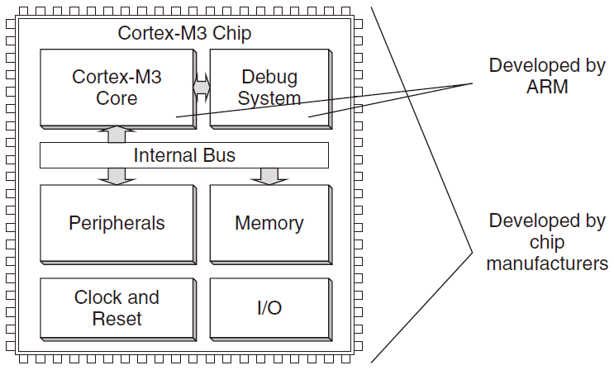
The Cortex-M3 Processor vs Cortex-M3-Based MCUs
The Cortex-M3 processor is the central processing unit (CPU) of a microcontroller chip
In addition, a number of other components are required for the whole Cortex-M3 processor-based microcontroller
Cortex-M3 processor based chips from different manufacturers will have different memory sizes, types, peripherals, and features

Slide 16
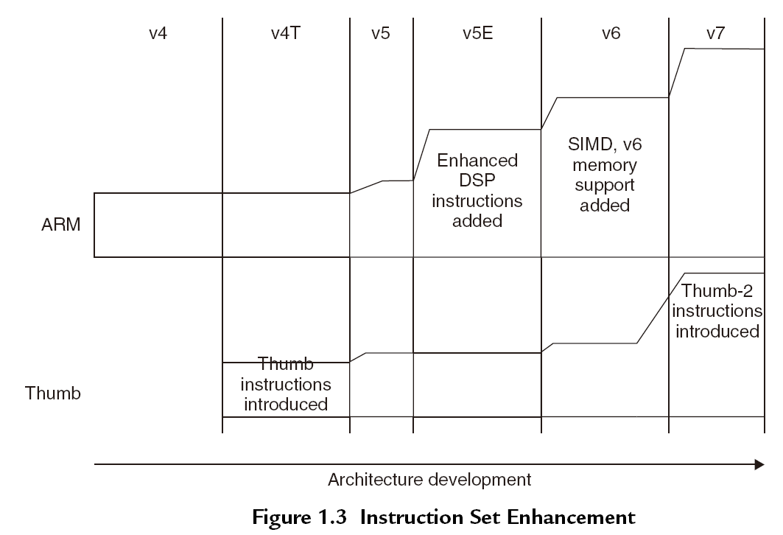
Instruction Sets of ARM Processors
Previous ARM processors support both ARM state and Thumb state
ARM state
ARM instructions that are 32-bit
Thumb state
Thumb instructions that are 16-bit
Notes:
the ARM instructions that are 32-bit and Thumb instructions that are 16-bit. During
program execution, the processor can be dynamically switched between the ARM state or
the Thumb state to use either one of the instruction sets. The Thumb instruction set provides
only a subset of the ARM instructions, but it can provide higher code density. It is useful for
products with tight memory requirements.
In 2003, ARM announced the Thumb-2 instruction set, which is a new superset of Thumb instructions that
contains both 16-bit and 32-bit instructions.

Slide 17
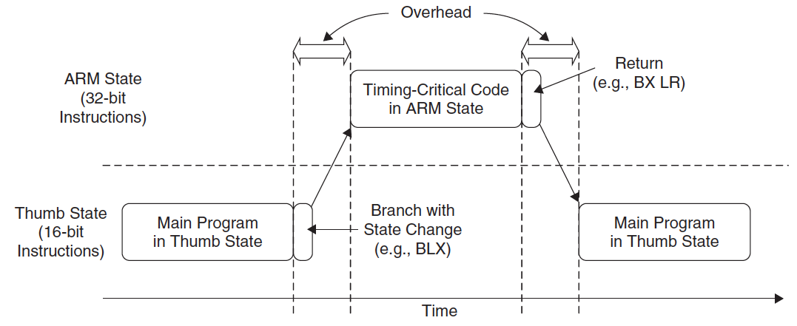

Instruction State Switches
In the ARM state, the instructions are 32-bit and can execute all supported instructions with very high performance
In the Thumb state, the instructions are 16-bit, so there is a much higher instruction code density
Can we combine them to achieve the best of both worlds?
Problems:
overhead of state switches
complex software development
Notes:
the ARM instructions that are 32-bit and Thumb instructions that are 16-bit. During
program execution, the processor can be dynamically switched between the ARM state or
the Thumb state to use either one of the instruction sets. The Thumb instruction set provides
only a subset of the ARM instructions, but it can provide higher code density. It is useful for
products with tight memory requirements.
In 2003, ARM announced the Thumb-2 instruction set, which is a new superset of Thumb instructions that
contains both 16-bit and 32-bit instructions.

Slide 18
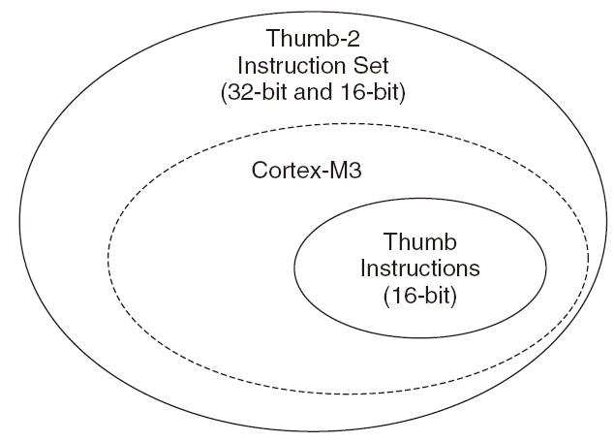
Instruction Set of Cortex-M3
Cortex-M3 supports only the Thumb-2 (and traditional Thumb) instruction set
Advantages:
No state switching overhead, saving both execution time and instruction space
No need to separate ARM code and Thumb code source fi les, making software development and maintenance easier
easier to write software because there is no need to worry about switching code
Notes:
the ARM instructions that are 32-bit and Thumb instructions that are 16-bit. During
program execution, the processor can be dynamically switched between the ARM state or
the Thumb state to use either one of the instruction sets. The Thumb instruction set provides
only a subset of the ARM instructions, but it can provide higher code density. It is useful for
products with tight memory requirements.
In 2003, ARM announced the Thumb-2 instruction set, which is a new superset of Thumb instructions that
contains both 16-bit and 32-bit instructions.

Slide 19
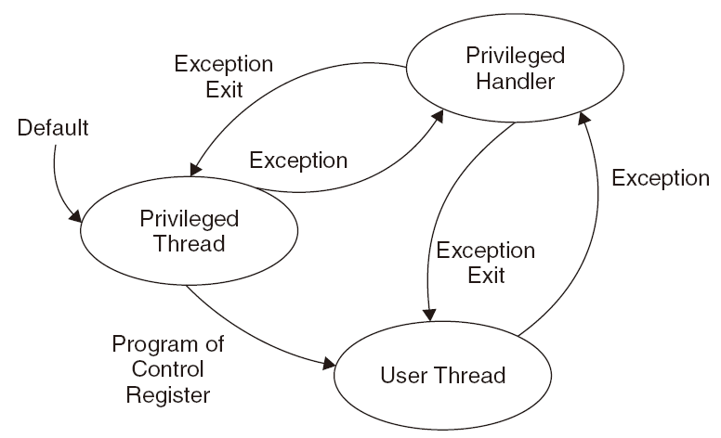
Operation modes in Cortex-M3
Two modes and two privilege levels

Slide 20
8.3 Cortex-M3 Basics
8.3.1 Registers
general registers
stack register
link register
program counter
special registers

Slide 21
8.3.1.1 General-Purpose Registers
1. R0~R7 (low registers):
Accessed by all 16-bit Thumb instructions and all 32-bit Thumb-2 instructions; reset value is unpredictable
2. R8~R12 (high registers):
Accessible by all Thumb-2 instructions but not by all 16-bit Thumb instructions; reset value is unpredictable

Slide 22
8.3.1.2 Stack Pointers
R13 is the stack pointer. Two stack pointers are banked so that only one is visible at a time.
The two stack pointers are:
1. Main Stack Pointer (MSP) : This is the default stack pointer, used by the OS kernel, exception handlers, and privileged-mode programs
2. Process Stack Pointer (PSP) : Used by the user application code
Notes:
In the Cortex-M3 processor, there are two stack pointers. This duality
allows two separate stack memories to be set up.

Slide 23
Stack: a first-in last-out buffer
The stack pointers are used for accessing stack memory processes such as PUSH and POP
Used to store register contents to stack memory at the start of a subroutine and then restore the registers from stack at the end of the subroutine.

Slide 24
More about stack in Cortex-M3
Cortex-M3 uses a full-descending stack arrangement
The stack pointer decrements when new data is pushed in the stack
The assembly language syntax is as follows:
PUSH {R0} ; R13=R13-4, then Memory[R13]=R0
POP {R0} ; R0=Memory[R13], then R13=R13+4
Either R13 or SP can be used in your program codes (referring to the MSP/PSP)
A particular stack pointer (MSP/PSP) can be accessed using special register access instructions (MRS/MSR)

Slide 25
More about stack in Cortex-M3
Since PUSH and POP operations are always word aligned, the stack pointer R13 bit 0 and bit 1 are hardwired to zero and always read as zero (RAZ)

Slide 26
8.3.1.3 Link Register
R14 is the link register (LR). LR is used to store the return program counter when a subroutine or function is called.
e.g., when using the BL (Branch with Link) instruction:
main ; Main program
…
BL function1 ; Call function1 using Branch with Link instruction:
; PC = function1
; LR = the next instruction in main
…
function1
… ; Program code for function 1
BX LR ; Return

Slide 27
8.3.1.4 Program Counter
R15 is the program counter (PC).
When you read this register you will find that the value is different than the location of the executing instruction by 4, due to the pipelining of the processor
Example:
0x1000 : MOV R0, PC ; R0 = 0x1004
When reading the PC, the LSB (bit 0) is always 0.
Why?
When writing to the PC, it will cause a branch. (Can you write to the PC in 8086?); the LSB must be set to 1 to indicate the Thumb state operations (setting to 0 implies to switch to the ARM state, which will result in a fault exception in Cortex-M3)

Slide 28
8.3.2 Special Registers
The special registers in the Cortex-M3 processor include:
Program Status Registers (PSRs)
Interrupt Mask Registers (PRIMASK, FAULTMASK, and BASEPRI)
Control Register (CONTROL)
Can only be accessed via MSR and MRS instructions
E.g.,
MRS <reg>, <special_reg> ; Read special register
MSR <special_reg>, <reg> ; write to special register
Note: MSR and MRS cannot have memory addresses, only registers are allowed

Slide 29
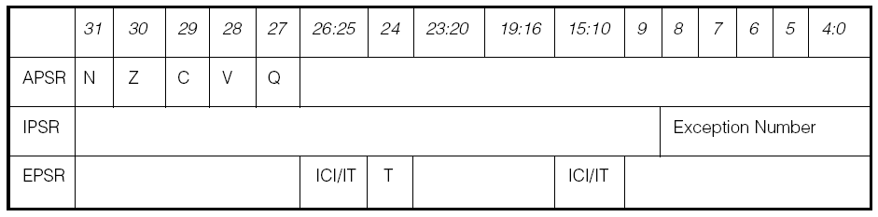
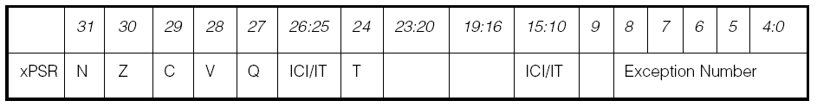
8.3.2.1 Program Status Registers (PSRs)
The program status registers are subdivided into three status registers:
1. Application PSR (APSR), 2. Interrupt PSR (IPSR), 3. Execution PSR (EPSR)
When they are accessed as a collective item, the name xPSR is used (PSR used in program codes).

Slide 30
EPSR and IPSR are read-only:
MRS r0, APSR ; Read Flag state into R0
MRS r0, IPSR ; Read Exception/Interrupt state
MRS r0, EPSR ; Read Execution state
MSR APSR, r0 ; Write Flag state
Accessing xPSR:
MRS r0, PSR ; Read the combined program status word
MSR PSR, r0 ; Write combined program state word

Slide 31
Bit Fields in Cortex-M3 Program Status Registers
Bit | Description
N | Negative
Z | Zero
C | Carry/borrow
V | Overflow
Q | Sticky saturation flag
ICI/IT | Interrupt-Continuable Instruction (ICI) bits, IF-THEN instruction status bit
T | Thumb state, always 1; trying to clear this bit will cause a fault exception
Exception Number | Indicates which exception the processor is handling

Slide 32
8.3.2.2 PRIMASK, FAULTMASK and BASEPRI Registers
The PRIMASK, FAULTMASK, and BASEPRI registers are used to disable exceptions.
Cortex-M3 Interrupt Mask Registers
Register Name | Description
PRIMASK | A 1-bit register. When this is set, it allows NMI and the hard fault exception; all other interrupts and exceptions are masked; default is 0 (no masking)
FAULTMASK | A 1-bit register. When this is set, it allows only the NMI, and all interrupts and fault handling exceptions are disabled; default is 0
BASEPRI | A register of up to 9 bits. It defines the masking priority level. When this is set, it disables all interrupts of the same or lower level (larger priority value); default is 0

Slide 33
To access the PRIMASK, FAULTMASK, and BASEPRI registers, the MRS and MSR instructions are used.
Example:
MRS r0, BASEPRI ; Read BASEPRI register into R0
MRS r0, PRIMASK ; Read PRIMASK register into R0
MRS r0, FAULTMASK ; Read FAULTMASK register into R0
MSR BASEPRI, r0 ; Write R0 into BASEPRI register
MSR PRIMASK, r0 ; Write R0 into PRIMASK register
MSR FAULTMASK, r0 ; Write R0 into FAULTMASK register
PRIMASK and BASEPRI are useful for temporarily disabling interrupts in timing-critical tasks; FAULTMASK is used by the OS kernel which cleans up a crashed task
The PRIMASK, FAULTMASK, and BASEPRI registers cannot be set in the user access level.

Slide 34
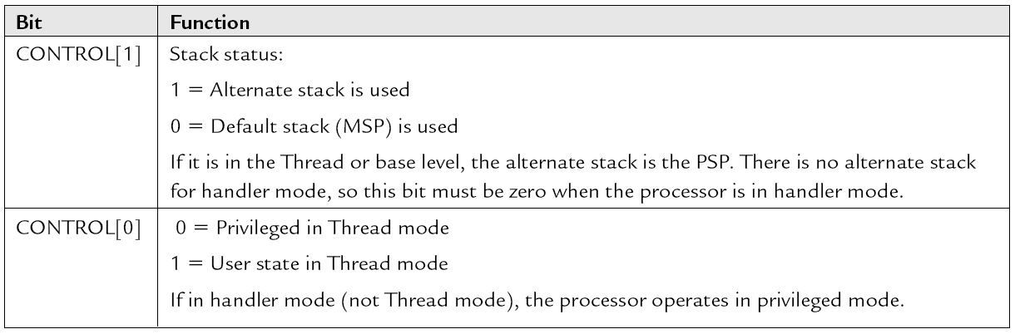
8.3.2.3 The Control Register
The Control register is used to define the privilege level and the stack pointer selection. This register has two bits.

Slide 35
CONTROL[1]
In Cortex-M3, the CONTROL[1] bit is always 0 (MSP) in handler mode. However, in the Thread mode, it can be either 0 or 1.
This bit is writable only when the core is in Thread mode and privileged.
CONTROL[0]
The CONTRL[0] bit is writable only in privileged level.
To access the Control register, the MRS and MSR instructions are used:
MRS r0, CONTROL ; Read CONTROL register into R0
MSR CONTROL, r0 ; Write R0 into CONTROL register

Slide 36
8.3.3 Operation Mode
Two modes and two privilege levels.
Operation Modes and Privilege Levels in Cortex-M3
 | Privileged Level | User Level
When running an exception | Handler Mode
When running main program | Thread Mode | Thread Mode
The operation modes determine whether the processor is running a normal program or running an exception handler.

Slide 37
When the processor exits reset, it is in Thread mode with privileged access level
In the user access level (Thread mode), access to the System Control Space (SCS, a memory block for configuration registers and debugging components) is blocked.
In the user access level, access to special registers (except the APSR) is also blocked. Fault exception will occur when trying to access SCS or special registers
Software in a privileged access level can switch the program into the user access level by setting CONTROL[0]=1
When an exception occurs, the processor will automatically switch to privileged state and return to the previous state when exiting the exception handler
Therefore, in order to change to privileged level, a user program has to go through an exception/interrupt handler which can set the CONTROL register before returns.

Slide 38
Switching of Operation Mode by Programming the Control Register or by Exceptions

Slide 39
When the Control register[0] = 0, only the processor mode changes when an exception takes place.
Switching Processor Mode at Interrupt

Slide 40
When the Control register[0] = 1, both processor mode and access level change when an exception takes place.
Switching Processor Mode and Privilege Level at Interrupt

Slide 41
8.3.4 Vector Tables
The vector table is an array of word data, with each representing the starting address of the ISR for one exception/interrupt type.
The base address of the vector table is relocatable (set the relocation register in the NVIC); initially, the base address is 0x0.
Example:
The reset is exception type 1. The address of the reset vector is 1 times 4, which equals 0x00000004; and NMI vector (type 2) is located in 2 * 4 = 0x00000008
The word stored at address 0x00000000 is used as the starting value for the MSP.

Slide 42
Vector Table Definition After Reset
Exception Type | Address Offset | Exception Vector
15 | 0x3C | SYSTICK
14 | 0x38 | PendSV
13 | 0x34 | Reserved
12 | 0x30 | Debug Monitor
11 | 0x2C | SVC
7-10 | 0x1C-0x28 | Reserved
6 | 0x18 | Usage fault
5 | 0x14 | Bus fault
4 | 0x10 | MemManage fault
3 | 0x0C | Hard fault
2 | 0x08 | NMI
1 | 0x04 | Reset
0 | 0x00 | Starting value of the MSP

Slide 43
8.3.5 Stack Memory Operations
8.3.5.1 Basic Operations of the Stack
Multiple registers can be pushed and popped in one instruction:
PUSH reglist ; push the large numbered registers first
POP reglist ; pop the low numbered registers first
Using PUSH and POP to return from subroutine
PUSH {R0-R7, LR} ; Save registers
…
POP {R0-R7, PC} ; Restore registers

Slide 44
8.3.5.2 Cortex-M3 Stack Implementation
The stack pointer (SP) points to the last data pushed to the stack memory, and the SP decrements first in a new PUSH operation.
Cortex-M3 Stack PUSH Implementation

Slide 45
For POP operations, the data is read from the memory location pointer by SP, then the stack pointer is incremented. The contents in the memory location are unchanged.
Cortex-M3 Stack POP Implementation

Slide 46
8.3.5.3 The Two-Stack Model in the Cortex-M3
The Cortex-M3 has two stack pointers: the Main Stack Pointer (MSP) and the Process Stack Pointer (PSP).
The SP register to be used is controlled by the Control register bit 1.
Control [1] = 0: Both Thread Level and Handler Use Main Stack

Slide 47
Control[1] = 1: Thread Level Uses Process Stack and Handler Uses Main Stack
The automatic stacking and unstacking mechanism will use PSP; whereas stack operations inside the handler will use MSP.

Slide 48
8.3.5.4 Reset Sequence
After the processor exits reset, it will read two words from memory:
1. Address 0x00000000: default value of R13 (MSP)
2. Address 0x00000004: Reset vector (the starting address of startup program; LSB should be set to 1 to indicate Thumb state)

Slide 49
Reset Sequence
The vector table starts after the initial SP value. In the Cortex-M3, vector addresses in the vector table should have their LSB set to 1 to indicate that they are Thumb code.

Slide 50
Assume that the stack memory range from 0x20007C00 to 0x20007FFF
Initial Stack Pointer Value and Initial Program Counter (PC) Value Example

